Slide 1
Lecture 9 Games and Adversarial Search
CS 180 – Intelligent Systems
Dr. Victor Chen
Fall 2022

Slide 2
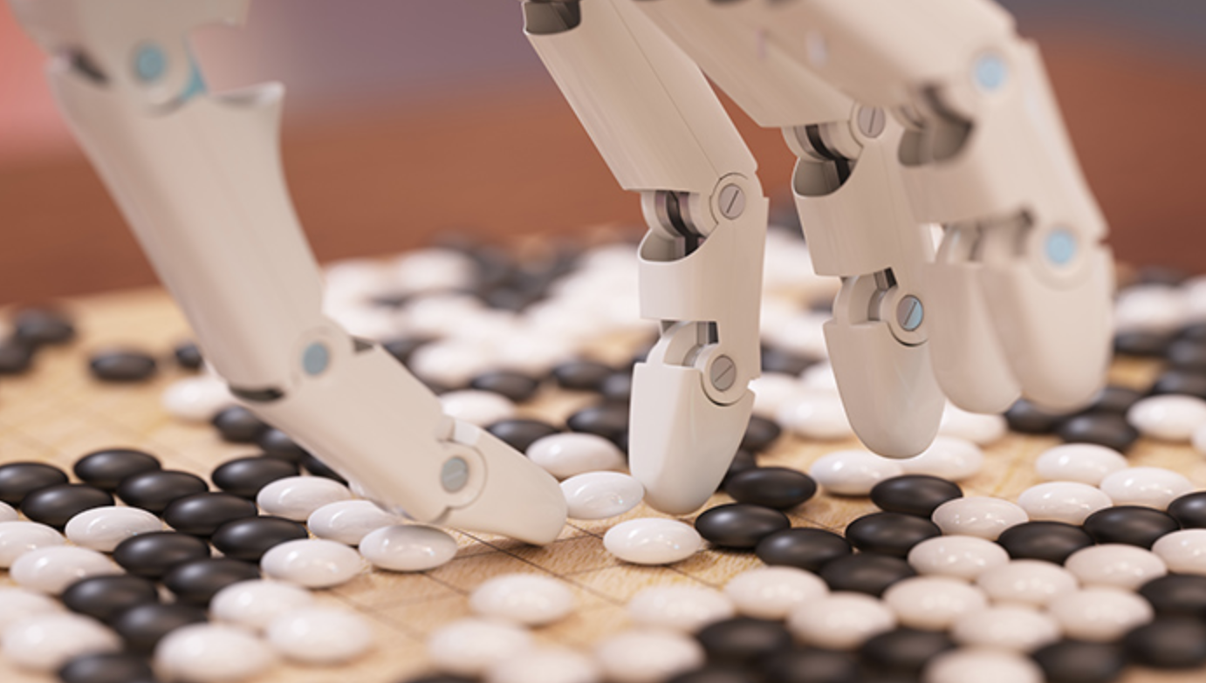
Games and adversarial search

Slide 3
Fully observable vs. partially observable
Fully observable: The values of all the state variables are known to the agent

Slide 4
Deterministic vs. stochastic
Deterministic: The next state is completely determined by the current state and the action being taken.
Otherwise, stochastic (outcomes are controlled by chance)

Slide 5
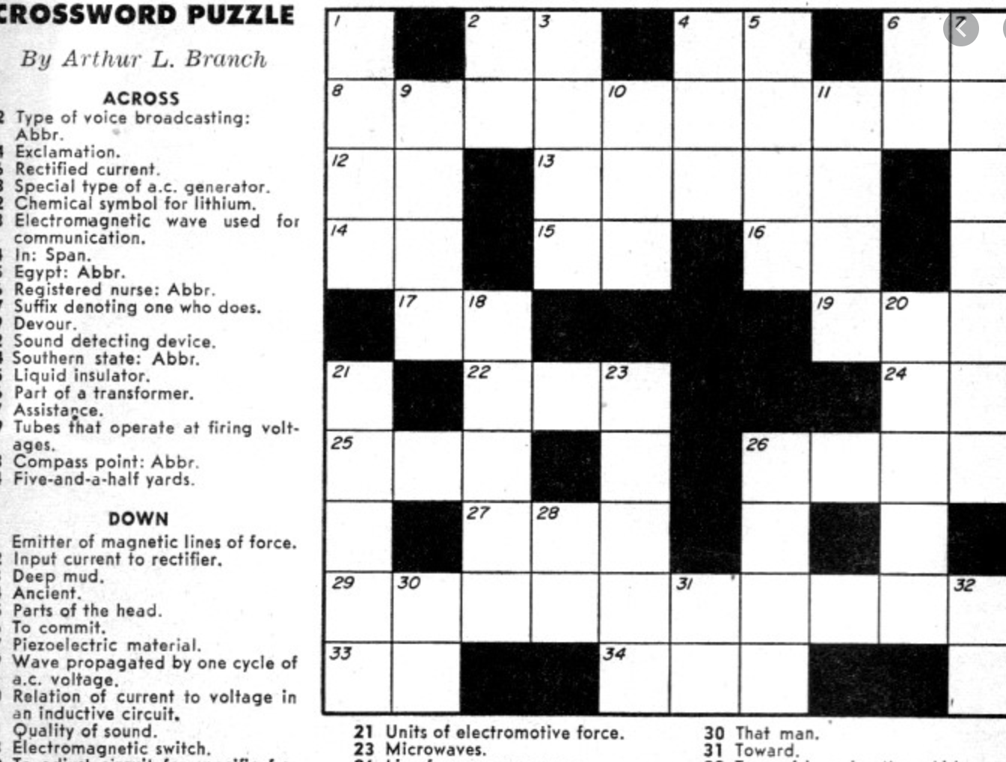
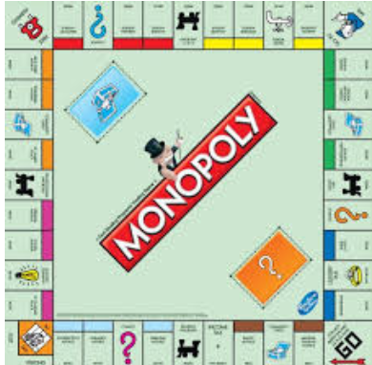
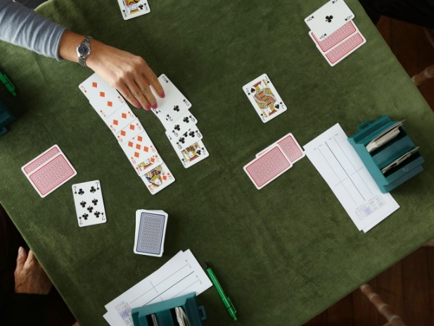
Types of game environments
Fully observable: The values of all the state variables are known to the agent
Deterministic: The next state is completely determined by the current state and the action being taken.
 | Deterministic | Stochastic
Perfect information (fully observable)
Imperfect information (partially observable)
Chess, checkers, go
Monopoly
Crossword puzzle
Scrabble, poker, bridge
Crossword puzzle
Monopoly
Bridge
Notes:
Backgammon, monopoly, because dice

Slide 6
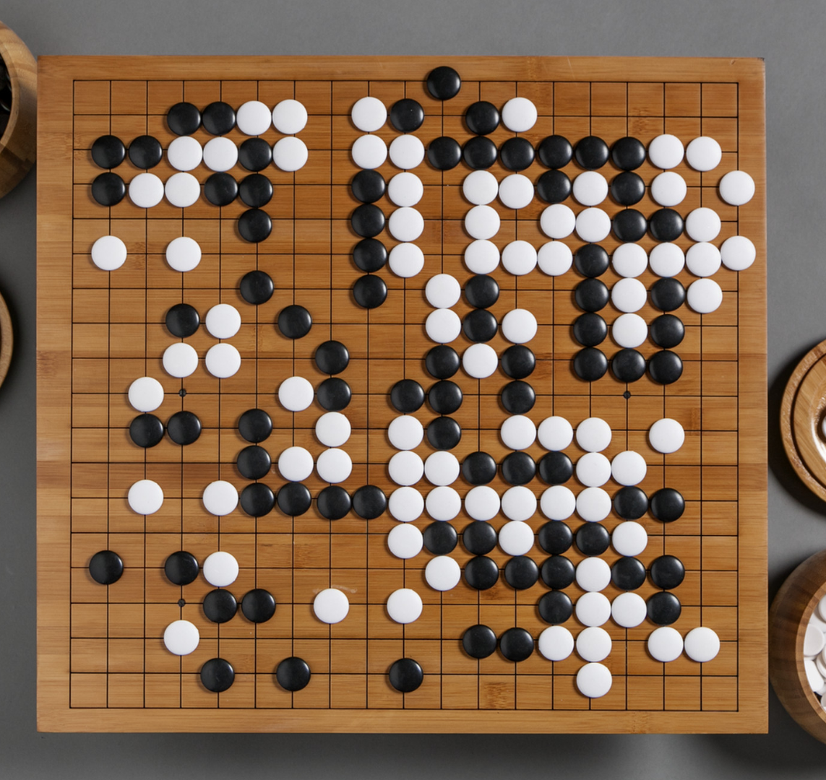
Our focus
In CSC180, we mainly focus on deterministic, fully observable, zero-sum games.
Go, chess, checkers

Slide 7
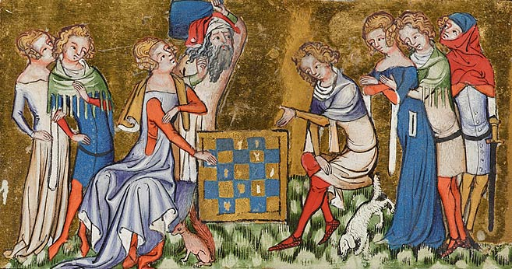
Zero-sum games
The sum of the amounts some players win equals the losses of the others.
Go, chess, checkers, poker and gambling are zero-sum games

Slide 8
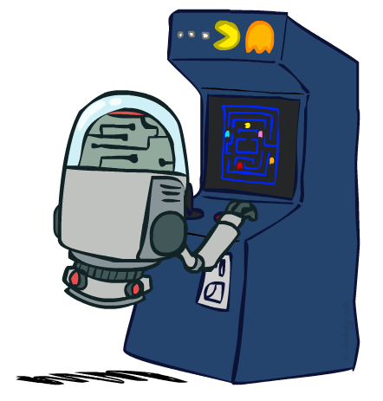
Build a game-playing AI agent…
Our goal: to look for such a policy that given a state, tells us what is best action/move in that state to maximize reward?

Slide 9
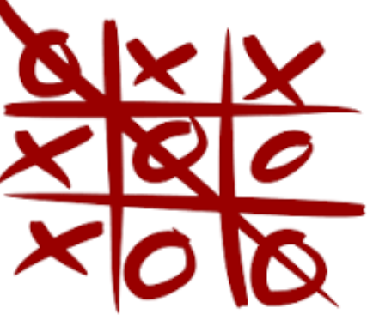
Take Tic-tac-toe as example
Tic-tac-toe: Two players take turns marking the spaces in a 3×3 grid. The player who places three same marks in a horizontal, vertical, or diagonal row wins the game

Slide 10
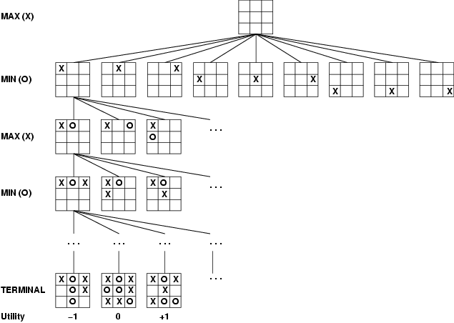
Game tree of tic-tac-toe
A game of tic-tac-toe between two players, “max” and “min”
Even a simple game like tic-tac-toe is too complex for us to draw the entire game tree !

Slide 11
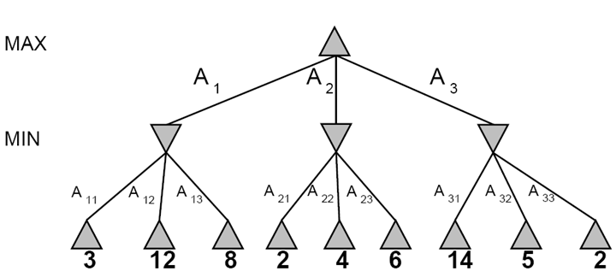
A abstract game tree for a trivial game
This is a zero-sum game
One player (MAX) maximizes result
The other (MIN) minimizes result
A game where two players (MAX and MIN) take turns.
are MAX nodes, in which it is MAX’s turn to move
are MIN nodes, in which it is MIN’s turn to move
Numbers on the leaf nodes (terminal states) are the reward MAX wins!

Slide 12
Smart search to win? Minimax search
Minimax search:
Compute each node’s minimax value:
Minimax value: The highest reward value MAX can achieve if MAX plays against an optimal adversary
Best move for MAX in a state is its successor state with the highest minimax value

Slide 13
Adversarial Search (Minimax search)
Minimax values: computed recursively
5
max
2
5
min
8
2
5
6
Reward (terminal) values

Slide 14
Derive Minimax values
def minimax_value(state):
if the state is a terminal state: return the state’s reward
if player = MAX: return max-value(state)
if player = MIN: return min-value(state)
def max-value(state):
initialize v = -∞
for each successor of state:
v = max(v, value(successor))
return v
def min-value(state):
initialize v = +∞
for each successor of state:
v = min(v, value(successor))
return v

Slide 15
Minimax Example
Minimax decision made for MAX
3
3
2
2
3
12
8
2
4
6
14
5
2
Each layer of the search tree is called a ply.

Slide 16
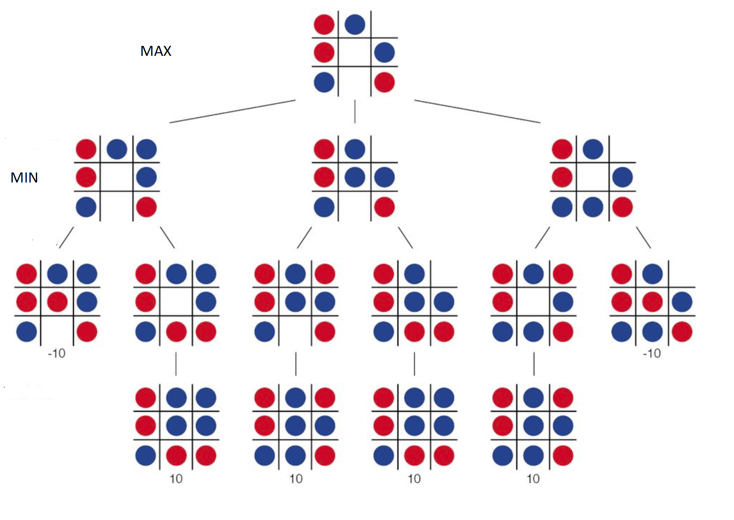
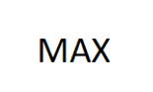
You are MAX in blue (tic-tac-toe)…

Slide 17
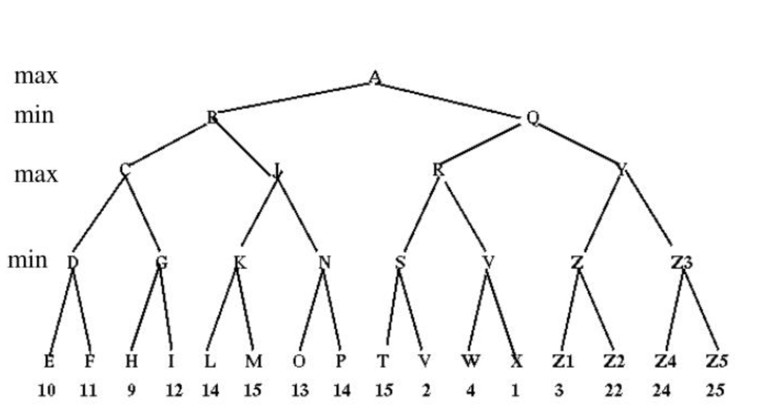
Practice
You play as MAX and you are at A now. Which state you should move to next?

Slide 18
Optimality of minimax
The minimax search is the optimal policy against an optimal adversary
If your adversary is suboptimal, your reward (utility) value can only be higher than if you were playing against an optimal adversary!

Slide 19
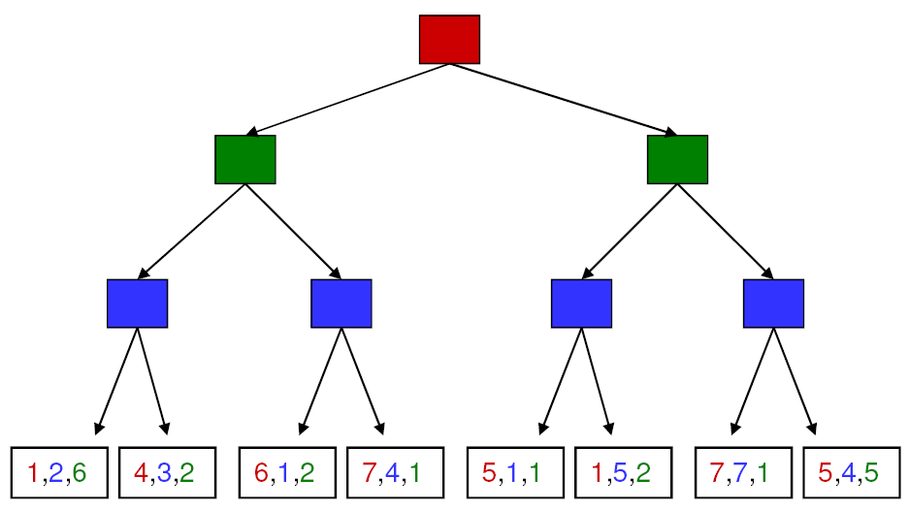
More than two players, non-zero-sum?
4,3,2
4,3,2
1,5,2
4,3,2
7,4,1
1,5,2
7,7,1
Minimax values become vector rather than scalar value
Each player maximizes her own reward at her node (assuming no alliances)

Slide 20
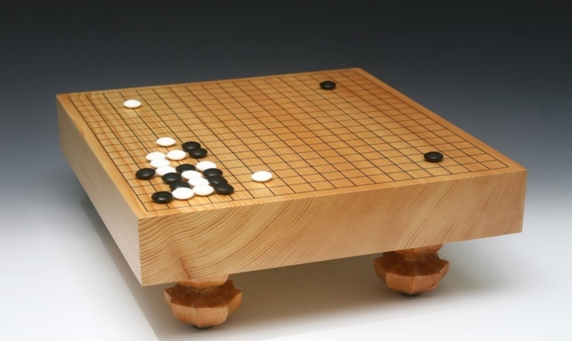
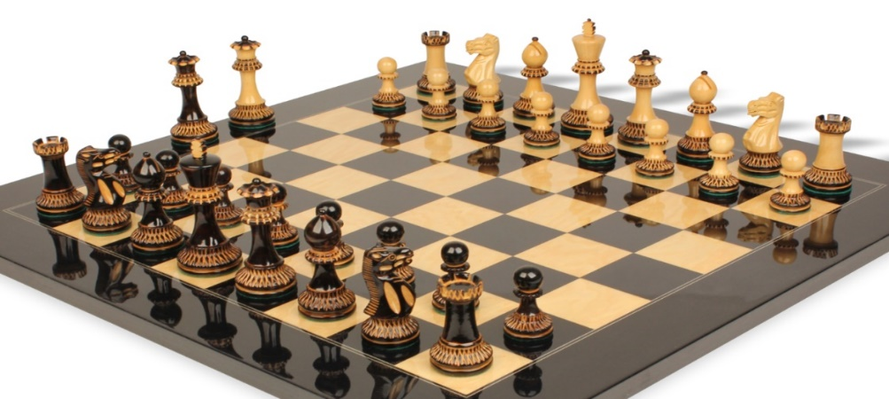
Minimax efficiency: Naïve DFS does not work
How efficient is minimax search?
Perform a complete DFS of the game tree. If tree depth is m and branching factor is b
Time: O(b^{m})
Space: O(bm)
Example: For chess, b ≈ 35, m ≈ 100
 | Board Size | Branching Factor (b)
Go | 19*19=361 | ≈250
Chess | 8*8=64 | ≈35

Slide 21

Minimax Efficiency
How to improve it?
Do we need to explore/search the whole tree?
No. We use tree pruning

Slide 22
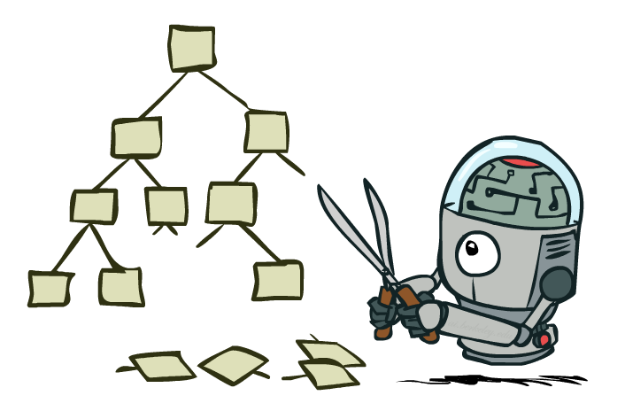
Game Tree Pruning

Slide 23
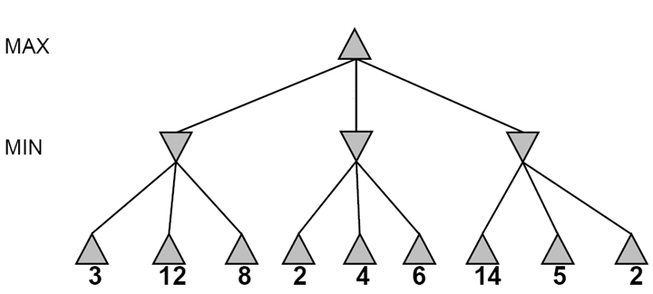
Alpha-beta pruning
Compute the minimax value of a node without expanding every nodes under each child of the current node

Slide 24
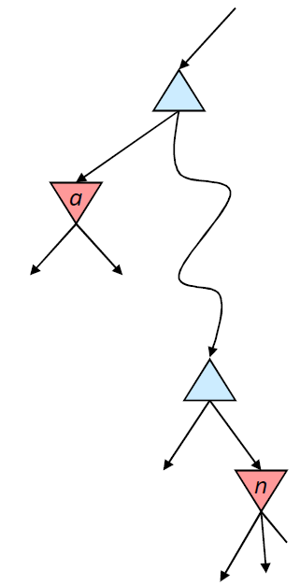
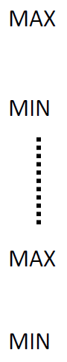
Alpha-beta pruning for MAX player
Suppose we are working at node n
Suppose α is the current best-choice value for MAX
As we loop over n ’s children, the value at node n decreases
If it drops below α, MAX will never choose n , so we can ignore n’s remaining children
α is a better choice than n
Analogously, β is the current best-choice value for MIN player
We want to estimate the minimax for this node.

Slide 25
Alpha-beta pruning
≥3
3

Slide 26
Alpha-beta pruning
≥3
Worse than 3! Pruning!
3
≤2

Slide 27
Alpha-beta pruning
≥3
3
≤2
≤14

Slide 28
Alpha-beta pruning
≥3
3
≤2
≤5

Slide 29
Alpha-beta pruning
3
3
≤2
2
Notes:
Could we have done better with the right branch?

Slide 30
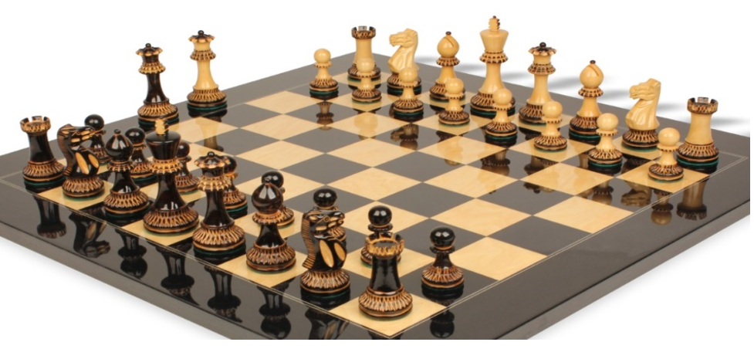
Alpha-beta search
Alpha-beta search
updates the values of α, β as the search goes
and prune the nodes whose values are worse than the current α or β value (current best choice) for MAX or MIN, respectively.
In chess, the branching is about 35. Alpha Beta search can reduce it to about 6 and therefore enables a 10 ply search on a regular PC.

Slide 31
Alpha-beta demo
http://homepage.ufp.pt/jtorres/ensino/ia/alfabeta.html

Slide 32
Reflection on Alpha-Beta search
Alpha-Beta pruning has no effect on the minimax value for the tree root node. However, the value at intermediate nodes may not be the exact minimax values. How to solve this?
Answer: We run alpha beta pruning for each child of the current node and then choose the action that moves to the successor with the maximum minimax value.
Good child ordering improves effectiveness of pruning.
With “perfect ordering”: Time complexity drops to O(bm/2).

Slide 33
Alpha-beta pruning with child ordering
≥3
Worse than 3! Pruning!
3
≤2

Slide 34
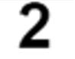
Alpha-beta pruning with child ordering
≥3
Worse than 3! Pruning!
3
≤2
≤2

Slide 35
Alpha-Beta search on deep tree game
Alpha beta pruning works only for small problems (shallow tree).
How can we apply alpha beta pruning to solve large problems?
Basic idea: We cut the tree at a certain depth to limit the search for a tradeoff between computation cost and decision optimality.
Approach: limited-depth alpha-beta search with heuristic function.

Slide 36
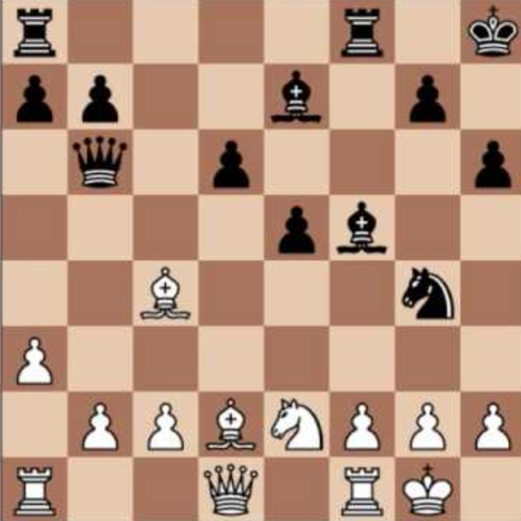
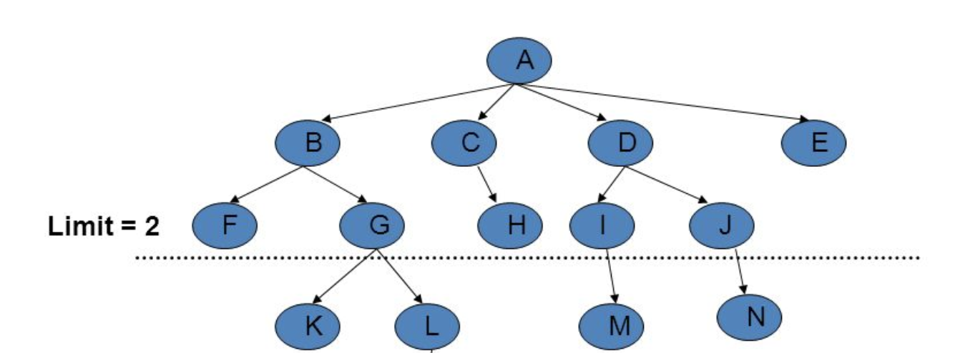

Limited-depth search with heuristic function
Step 1: We cut off the game tree at a certain depth, d, called a d-ply search.
Step 2: For any non-terminal states at the depth d, we apply some heuristic function to estimate the success likelihood (e.g., minimax value, the probability to win) of those states.
Step 3: Apply alpha-beta pruning in the d-ply search
What would be a good heuristic to estimate the success likelihood of a non-terminal states for chess?

Slide 37
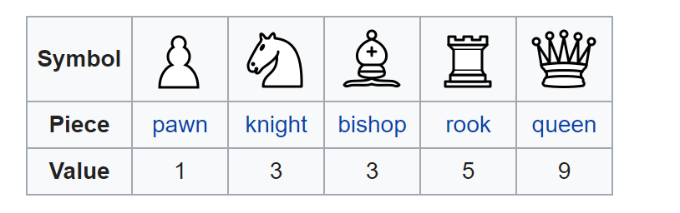
Heuristic function
A heuristic function could be as simple as a weighted sum of some features.
h(s) = w₁ f₁(s) + w₂ f₂(s) + … + w_{n} f_{n}(s)
Each feature:
f_{k}(s) is the advantage in terms of a piece, e.g., f₁(s) = (number of white queens)−(number of black queens)
w_{k} is the relative value of a piece (pawn = 1, knight = 3, rook = 5, queen = 9).

Slide 38
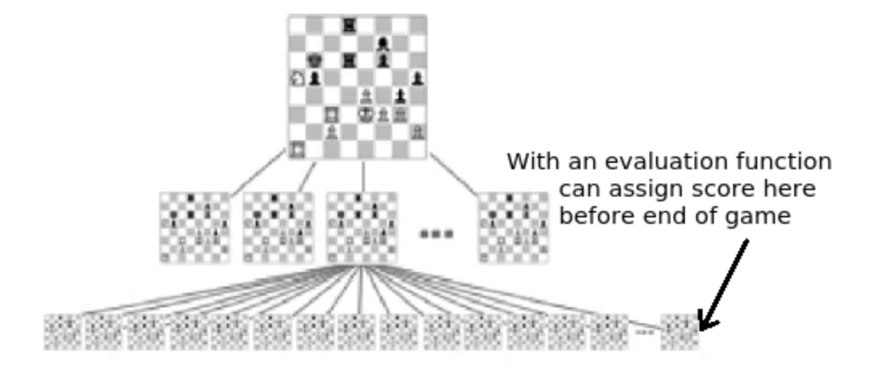
Limited-depth search with heuristic function

Slide 39
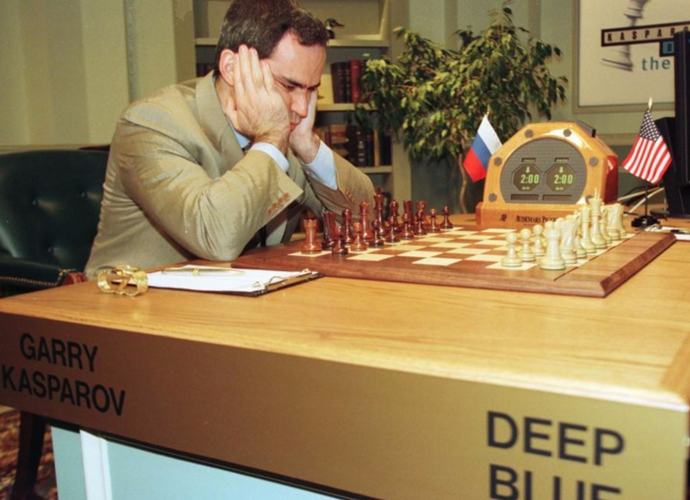
Limited-depth search with heuristic function
Deep Blue was a chess-playing agent developed by IBM.
Mainly based on limited-depth alpha-beta search with heuristic function.
Searches 200 million states per second, uses very sophisticated heuristic function, and performs search up to 40 ply.
Deep Blue beat human world champion Gary Kasparov in a six-game match in 1997.

Slide 40
Minimax alpha-beta pruning implementation

Slide 41
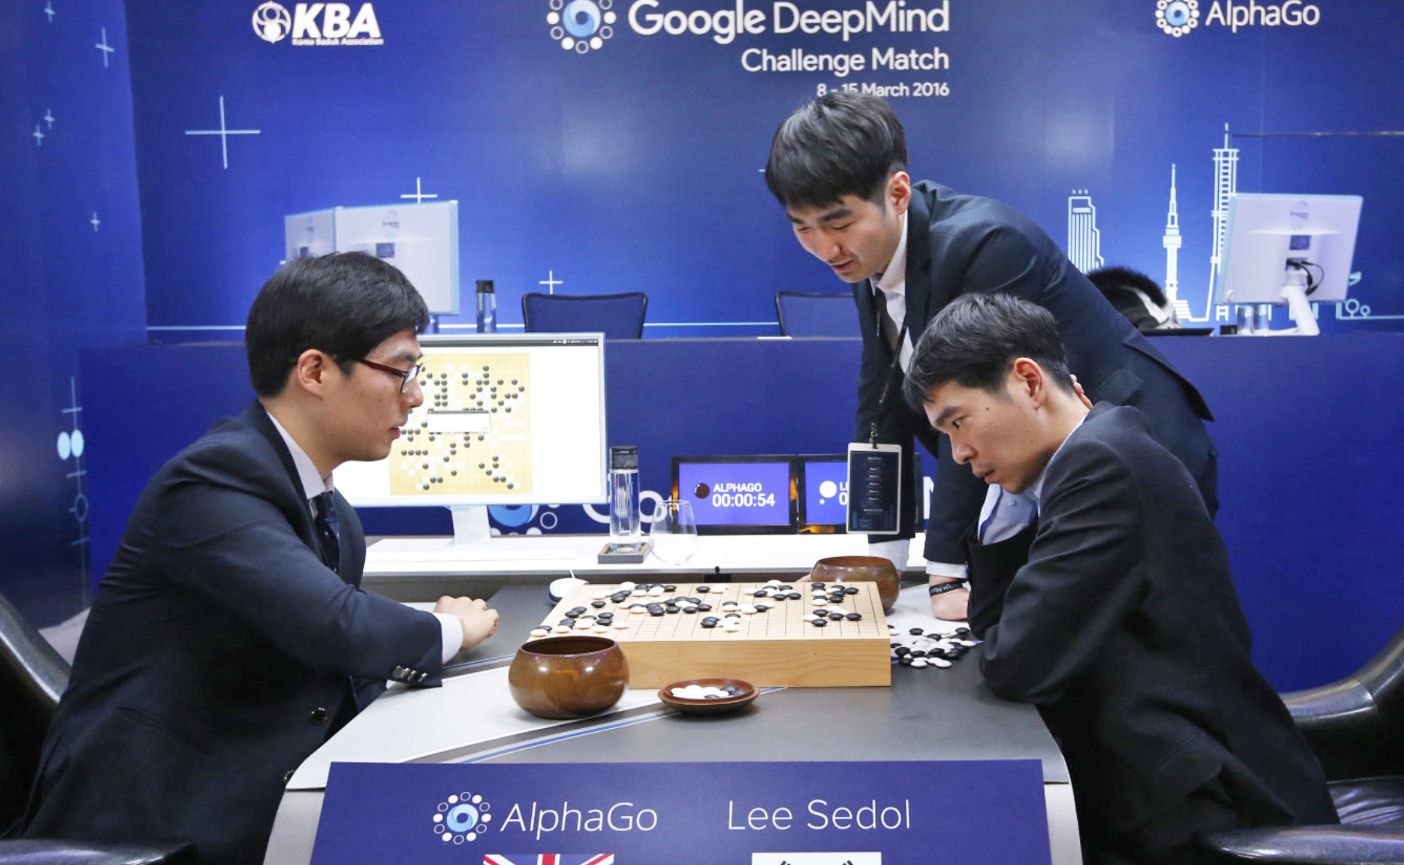
Beyond minimax search
Most game-playing AIs (Deep Blue) in the past are based on game tree search we learned in this lecture.
However, today’s game AIs (e.g., AlphaGo) rely less on tree search and more on knowledge (machine learning).

Slide 42
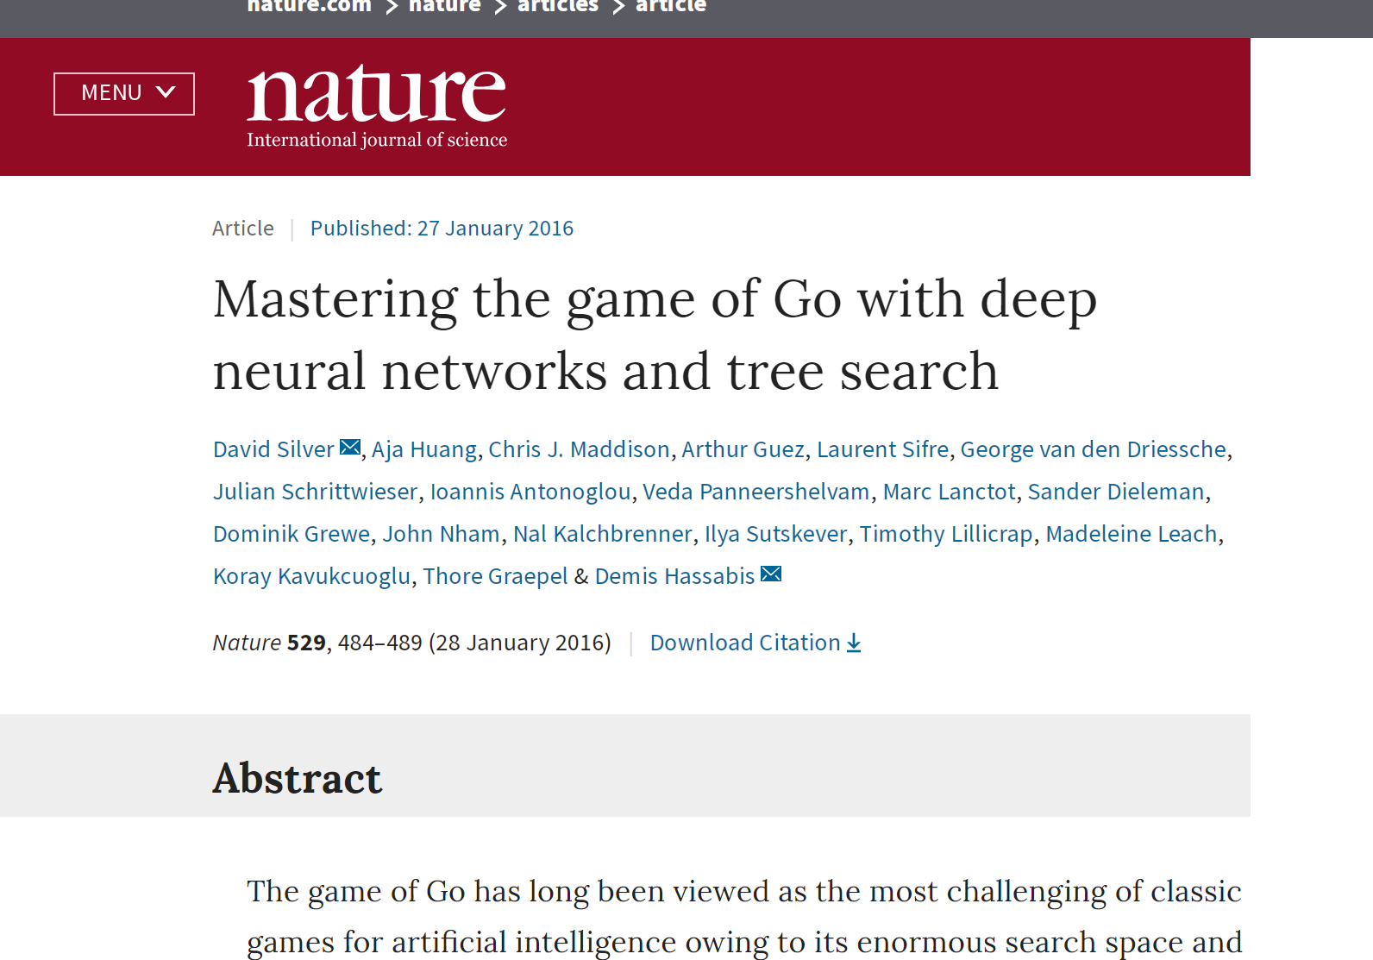
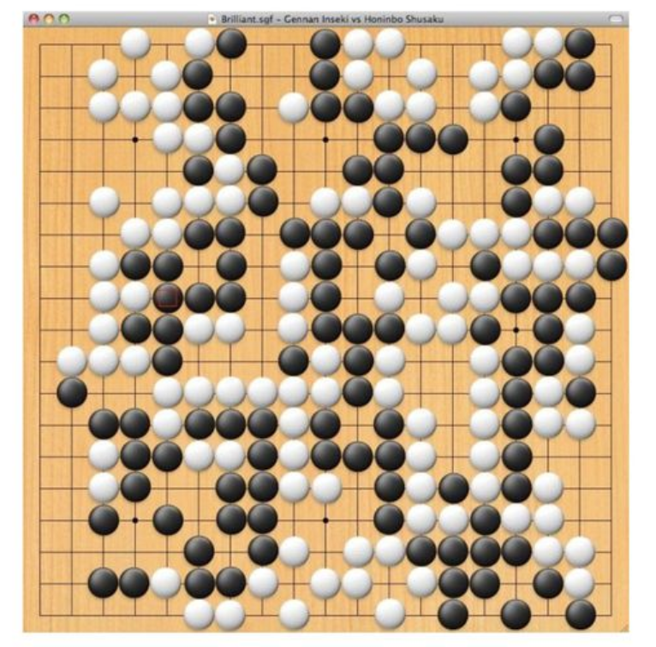
AlphaGo (an AI from Google)

Slide 43
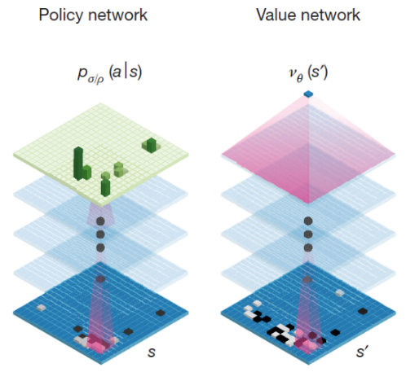
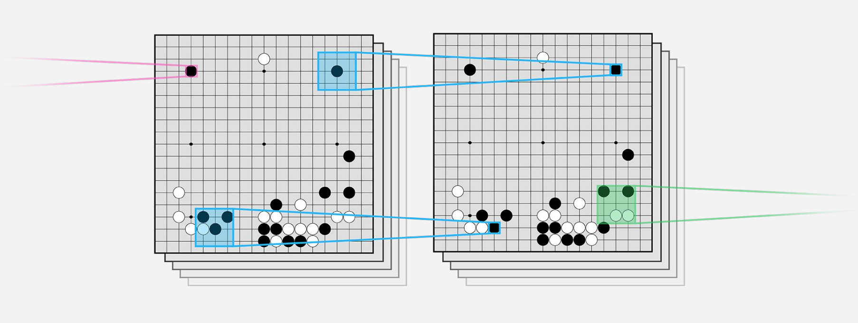
AlphaGo
Treat the Go board as an image

Slide 44
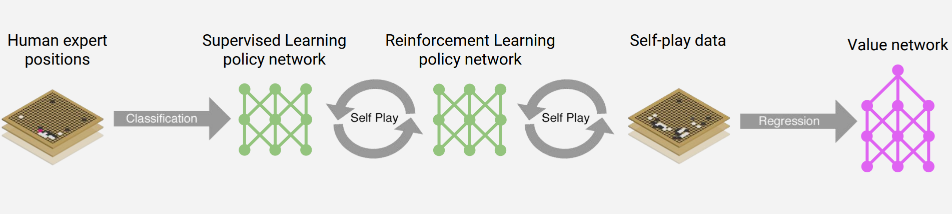
AlphaGo
Policy network (CNN) was trained to predict human moves
Value network (CNN) was trained to predict reward of each state.

Slide 45
AlphaGo uses two policy networks
SL policy network (CNN)
Given state s, predict probabilities of human moves
Trained on 30M positions (states) from human experts, 57% accuracy on predicting human moves
12 layer-CNN
4 weeks on 50 GPUs using Google Cloud
RL policy network (CNN)
Two CNN networks play against each other and update parameters.
Machine plays against itself (self-play)
12 layer-CNN
1 week on 50 GPUs using Google Cloud

Slide 46
AlphaGo uses one value network
Value network (CNN)
Given any state s, predict the reward of that state
This is a regression network use stochastic gradient descent (SGD) to minimize mean squared error (MSR) between actual rewards (based on self-play) and predicted rewards
12 layer CNN
Trained on 30M self-play positions (states)
1 week on 50 GPUs using Google Cloud

Slide 47
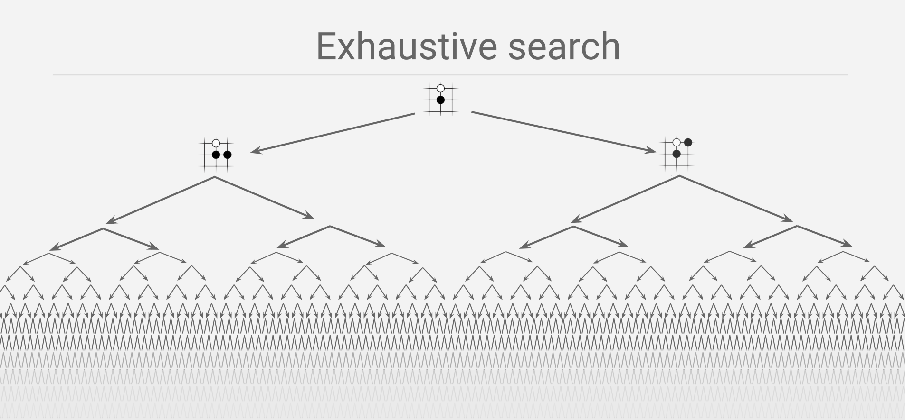
Tree pruning

Slide 48
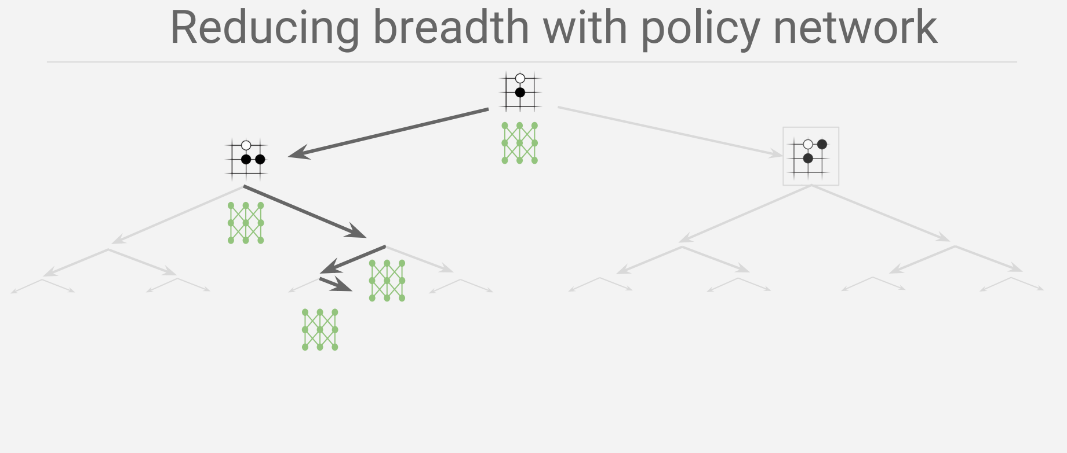
Policy network (CNN) was trained to predict human moves

Slide 49
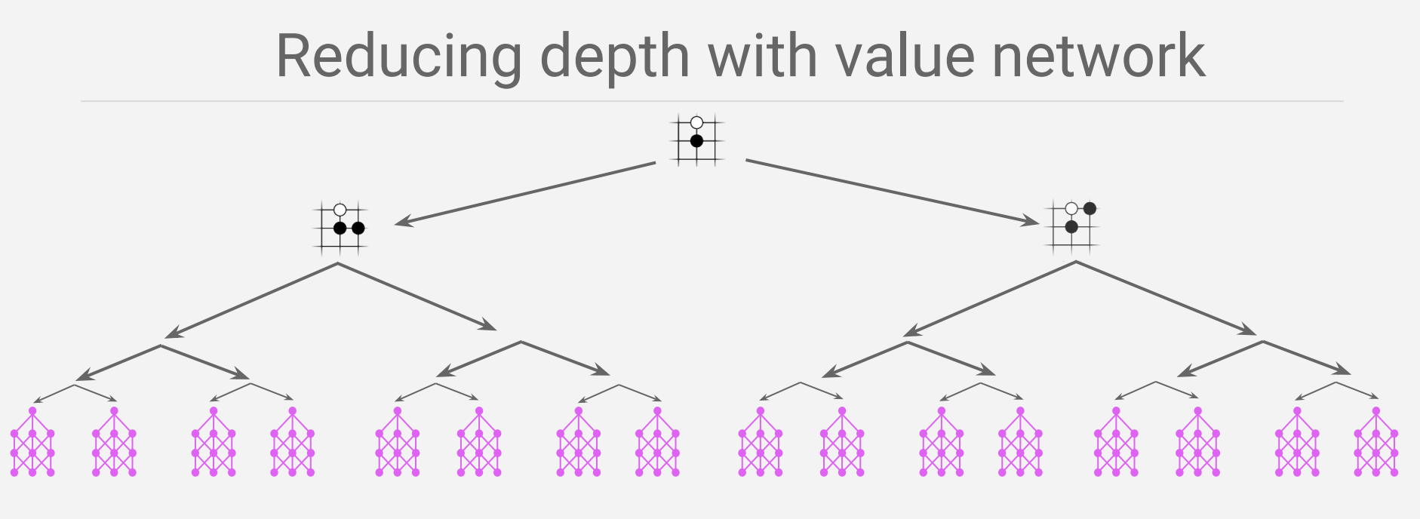
Value network (CNN) was trained to predict reward of each state.

